Slide 1
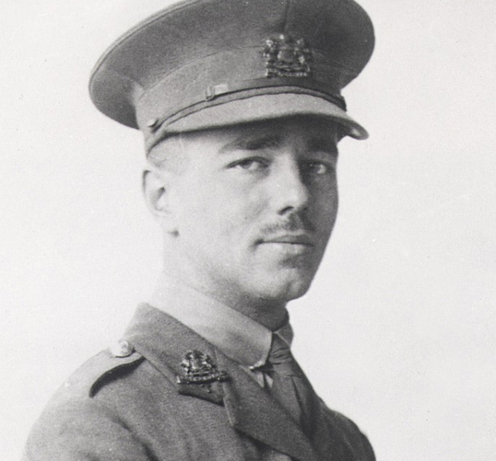
Wilfried Owen
Why is he a famous soldier?
Part I- His life
Part II- His work
Claire Lehut/ Elise Vasseur/ Lisa Manouvrier 2D5

Slide 2
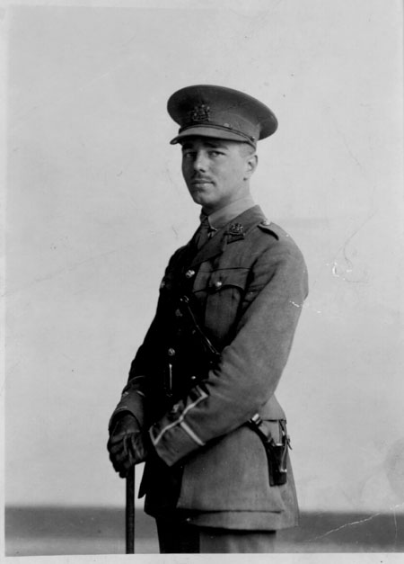
Introduction:
Today we will talk about Wilfried Owen, who is a soldier of the First World War, and we will try to explain why is he famous. First, we will interest ourselves at his life and then, at his works.

Slide 3
I- His life
Wilfried Owen was an English poet and soldier, one of
the main poets of WWI.
He was born on 18 March 1893 in Oswestry, Shropshire.
In 1915, he enlist in the army.
At hospital, he met the poet Siegfried Sassoon, who gave him encouragement and introduced him to literary figures.
After experiencing heavy fighting, he was diagnosed with shell shock.
On 4 November 1918, he was killed in France.

Slide 4
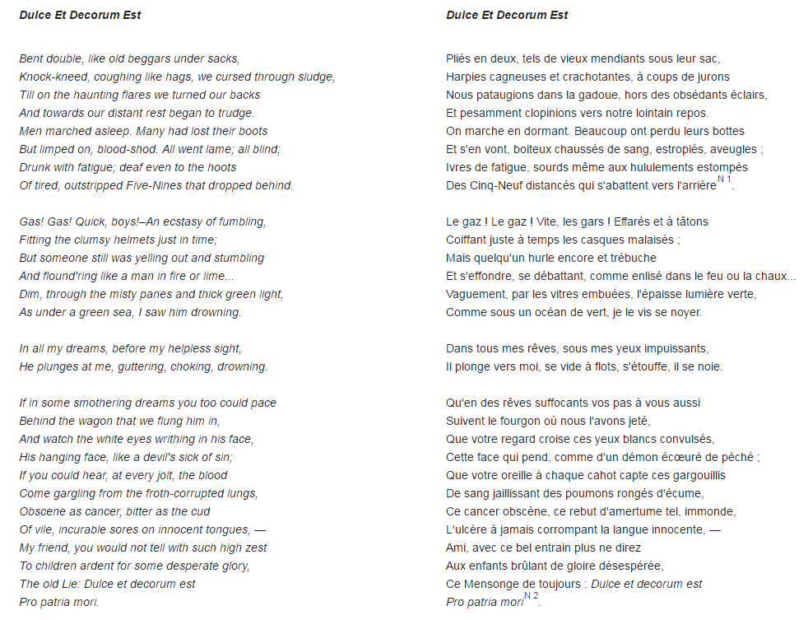
II- His works
Only five poems were published in his lifetime.
But after his death, seven more of his poems appeared.
One of his most famous poem.

Slide 5
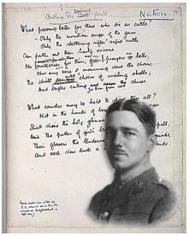
Conclusion:
Through his poems, Wilfred Owen was able to describe in an artistic way the horrors of war and his experience. What makes him a famous soldier of this terrible war.

